Slide 1
Large Language Model (LLM) Chatbot
OpeNai, Lang chain, OLLAMA, LLMA3.2, HUGGING-FACE
ZEESHAN HYDER

Slide 2
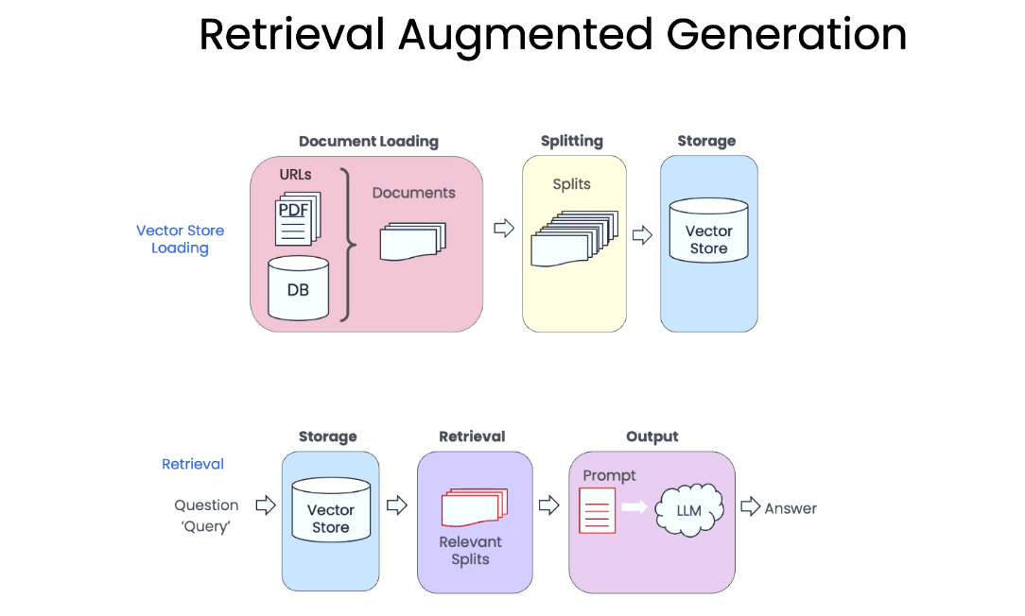
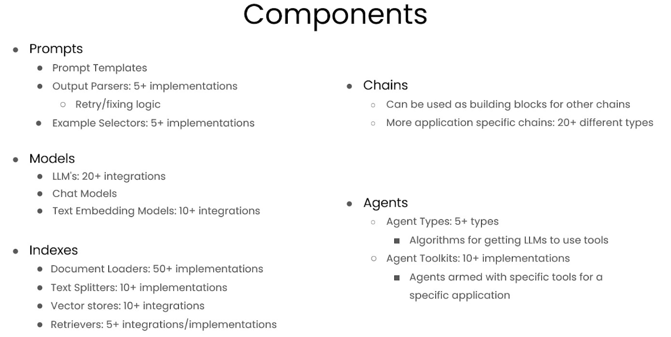
LangChain Framework
LangChain is an open-source developer framework for building LLM applications

Slide 3
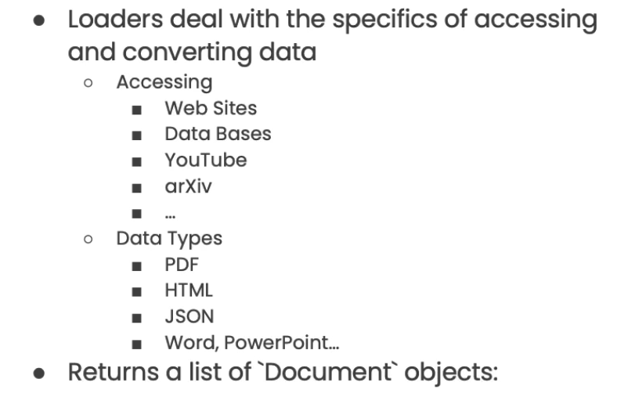
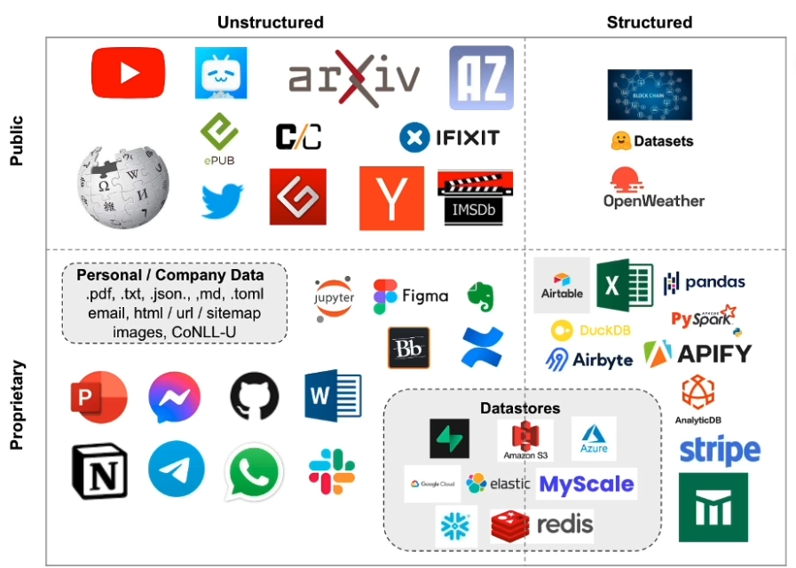
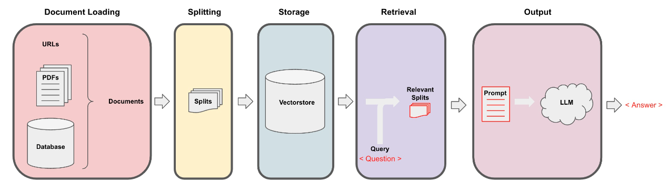
1) Document Loading
Retrieval augmented generation (RAG) framework
RAG is useful if we want to ask question about specific documents (e.g., our PDFs, a set of videos, etc).

Slide 4
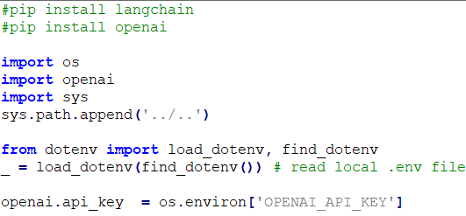
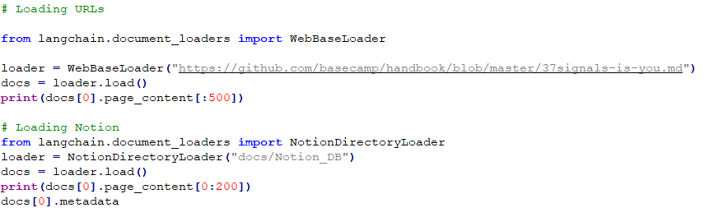
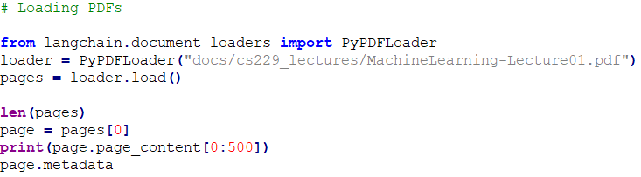
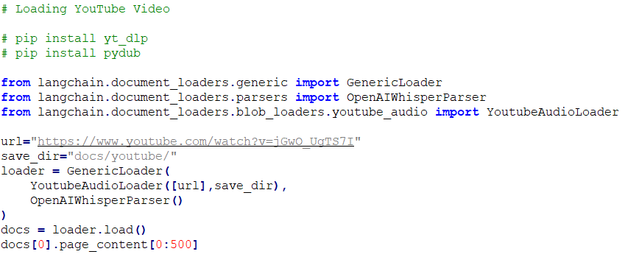
Code for document loading

Slide 5
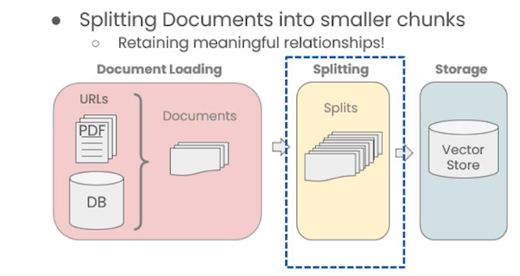
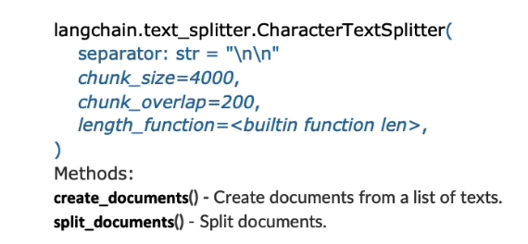
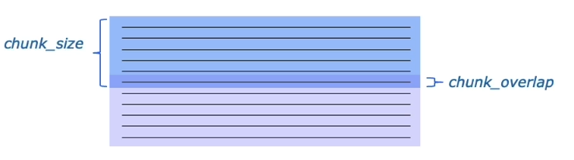
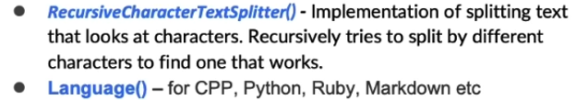
2) Document Splitting
Types of Splitters:

Slide 6
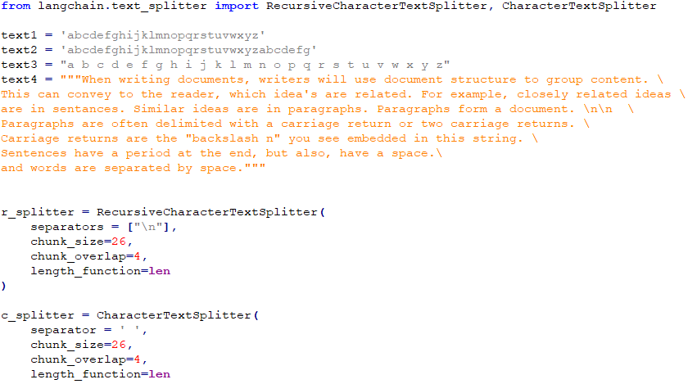
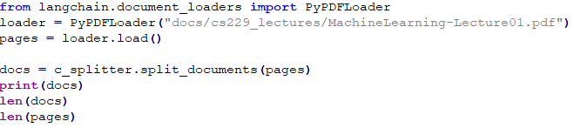
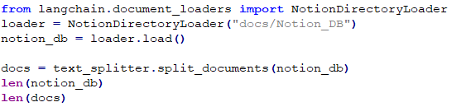
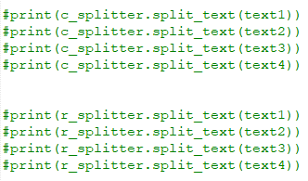
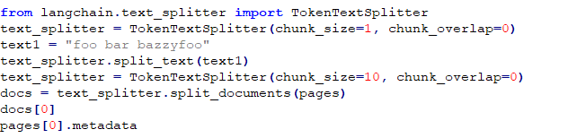
Code for document splitting
PDF splitting
Notion splitting
Token splitting

Slide 7
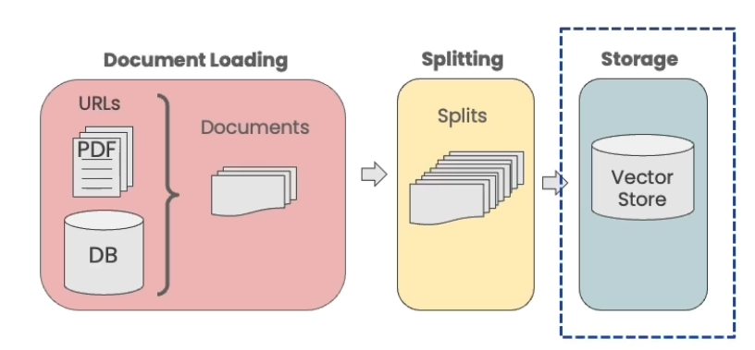
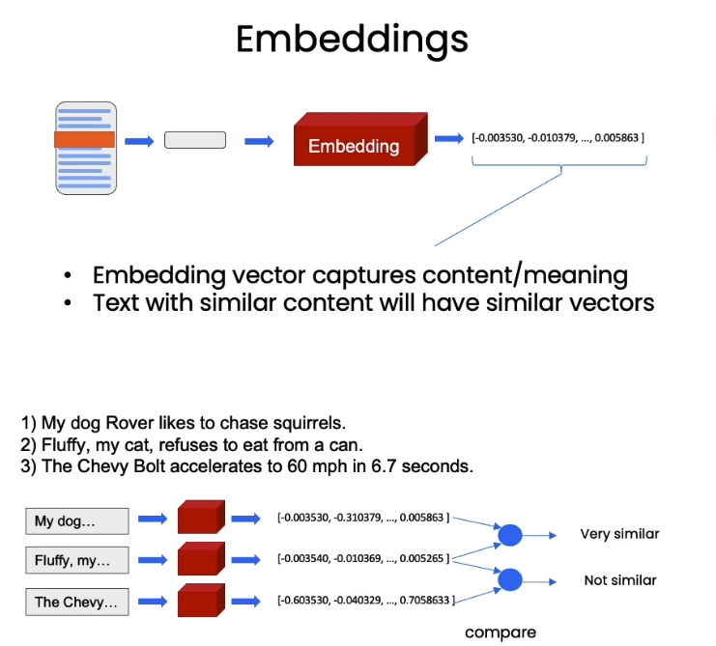
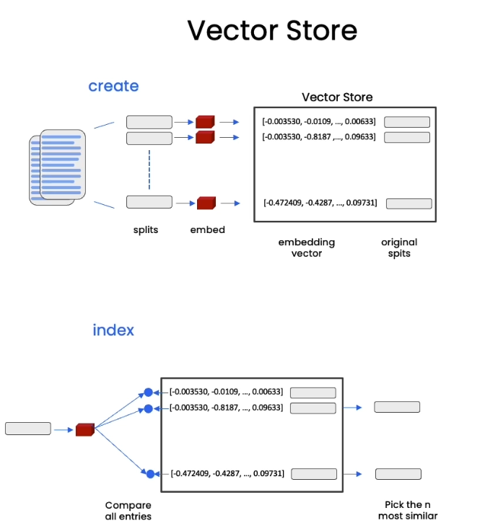

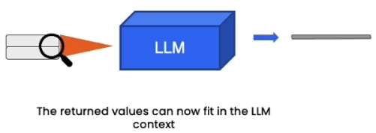
3) Vectorstores and Embeddings
query

Slide 8
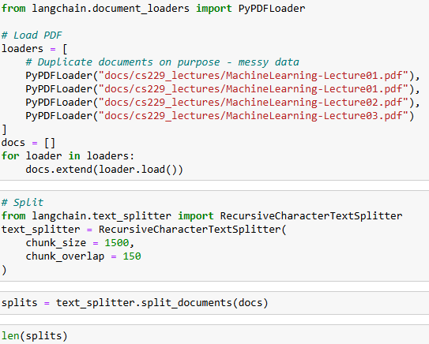
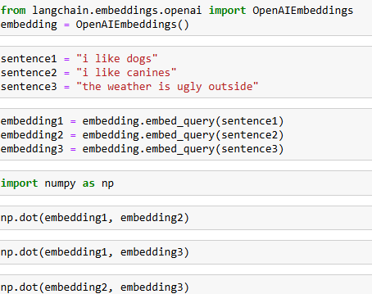
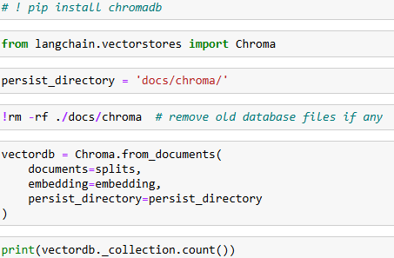
Code for Vectorstores and Embeddings
Loader and Splitter
Embeddings
Vector store

Slide 9
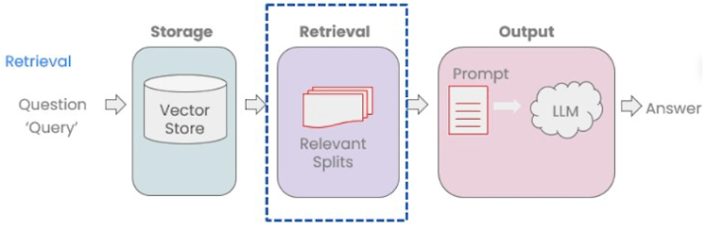
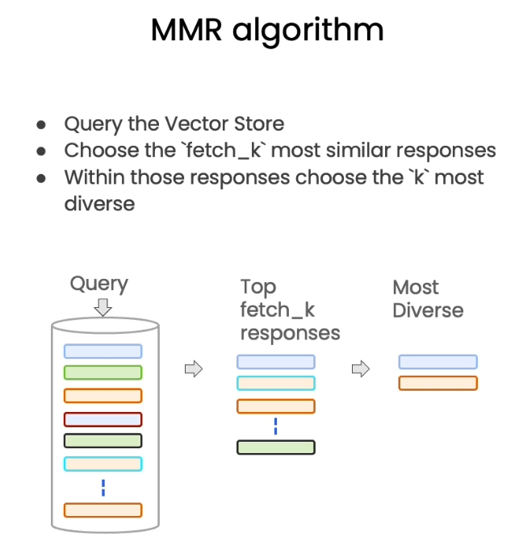
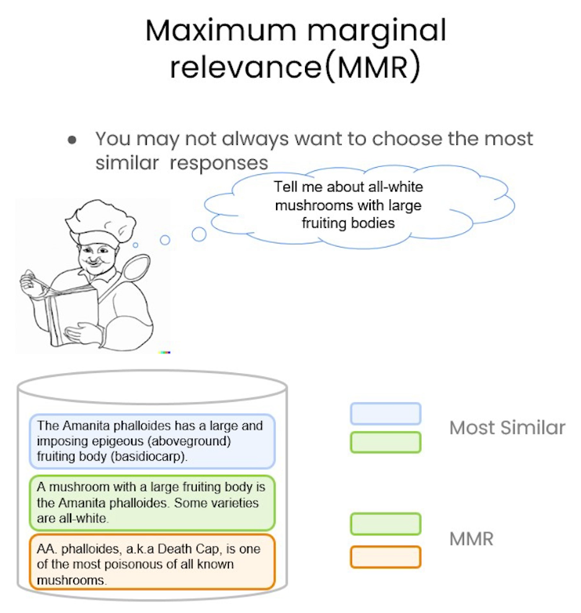
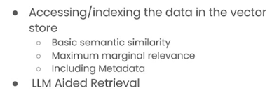
4) Retrieval

Slide 10
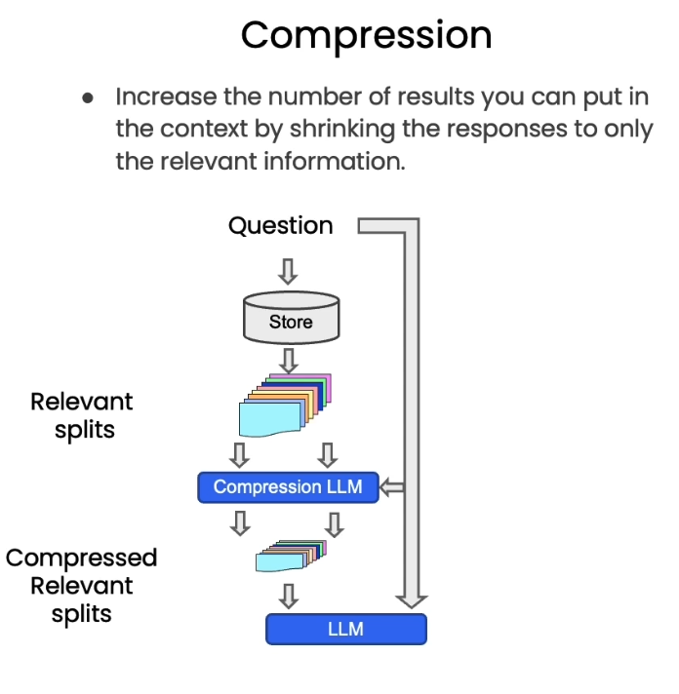
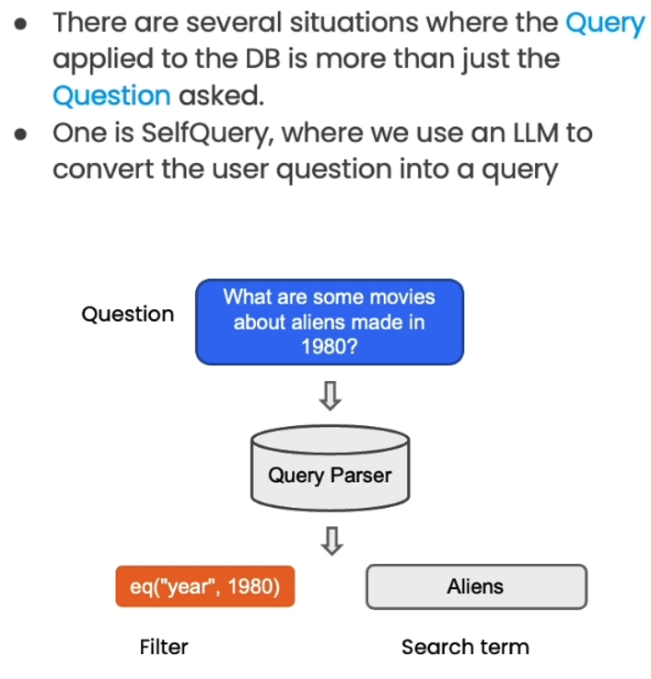
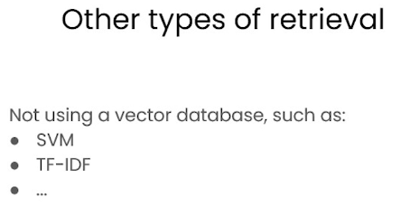
LLM Added Retrieval

Slide 11
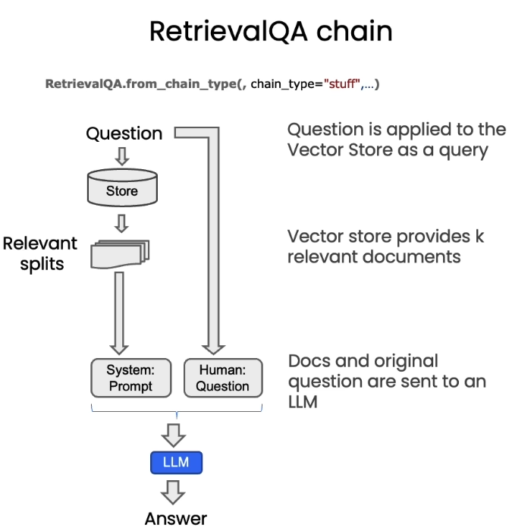
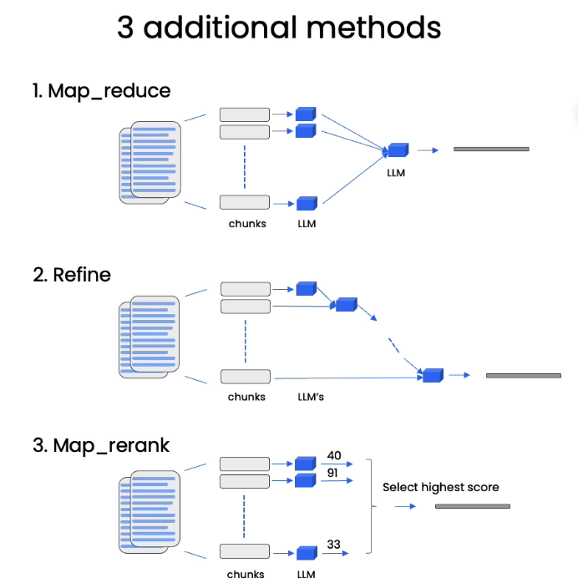
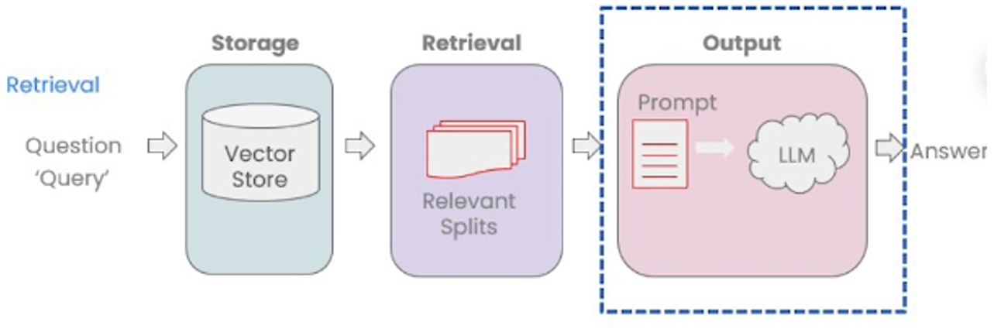
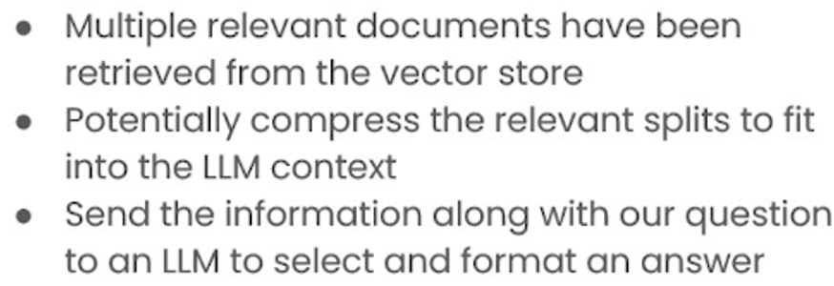
5) Question and Answering

Slide 12
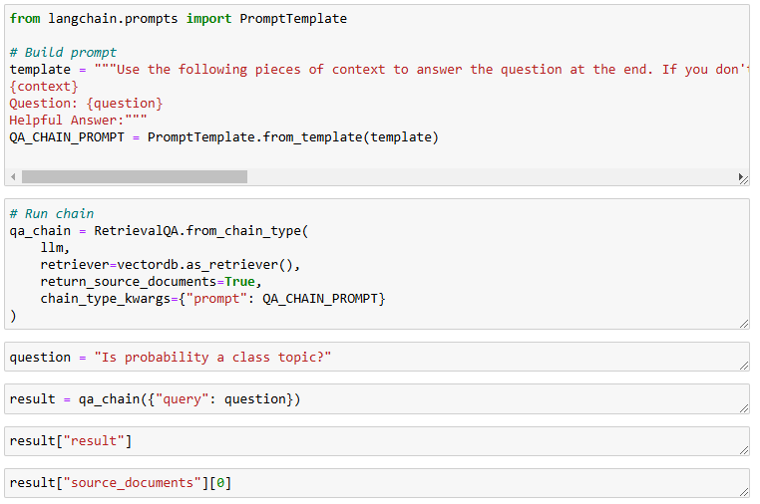
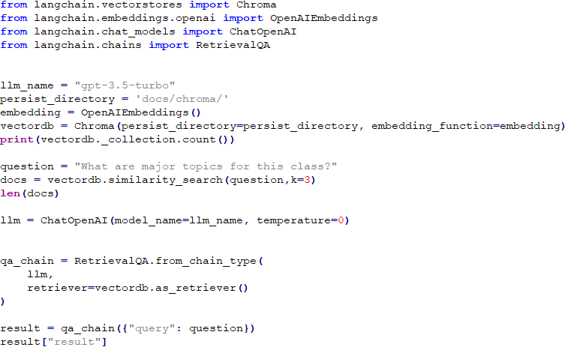
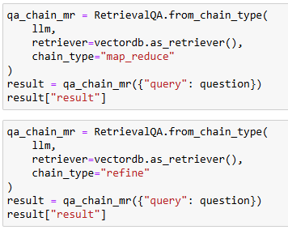
Code for Retrieval and Q&A
Prompt
RetrievalQA limitations
QA fails to preserve conversational history.
RetrievalQA chain types

Slide 13
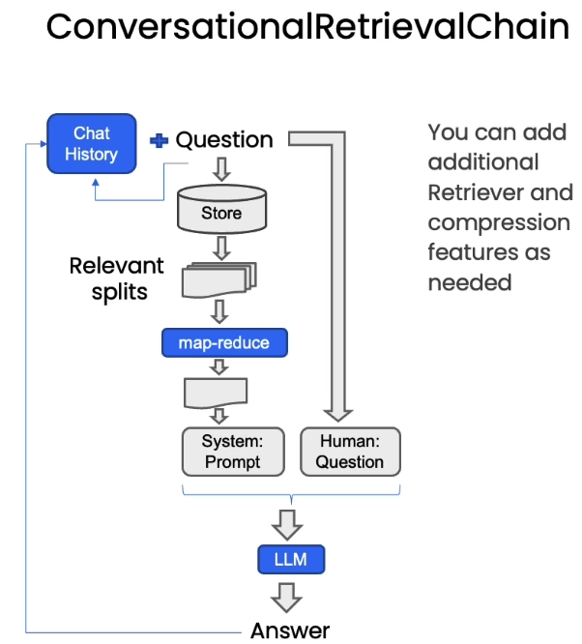
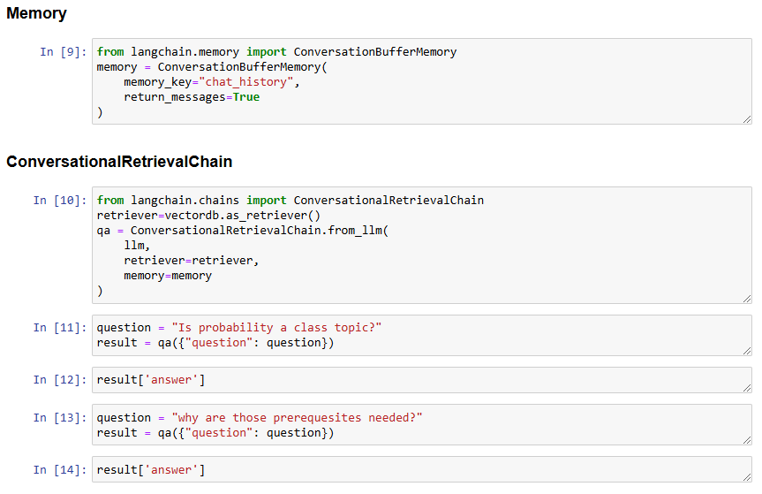
6) Chat History

Slide 14


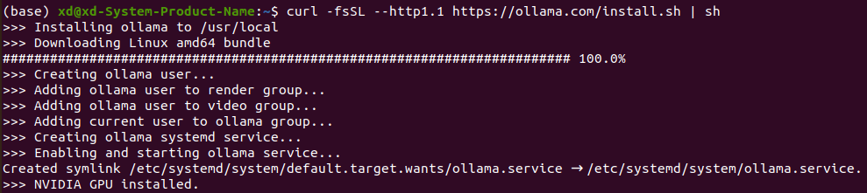
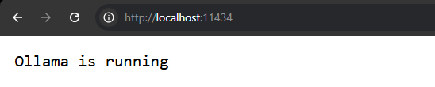
Install and RUN OLLAMA and LLMs; llama3.2, Mistral, and LLaVA
Ollama is an interface for running LLMs in Windows, Linux and Mac Computers
OLLAMA
For Linux Ubuntu
Make sure that your computer allow for inbound connections on port 11434. To do that, open terminal and type;
>> sudo ufw allow 11434/tcp
OUTPUT
To install Ollama in linux, open terminal and type
>> curl -fsSL https://ollama.com/install.sh | sh
Once you installed Ollama, verify that ollama is running by typing in browser;
Pull and run model you want: https://ollama.com/library
>> ollama pull llama3.2
>> ollama run llama3.2

Slide 15
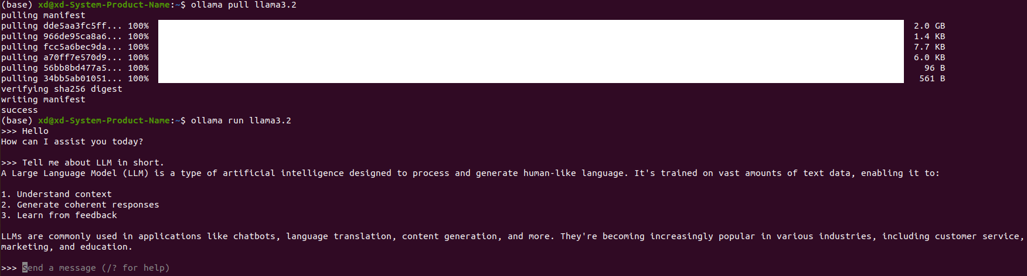
Demonstration: Chat with Ollama’s LLama3.2 Model Locally on terminal

Slide 16
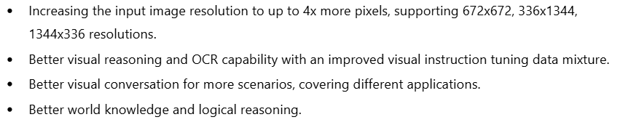
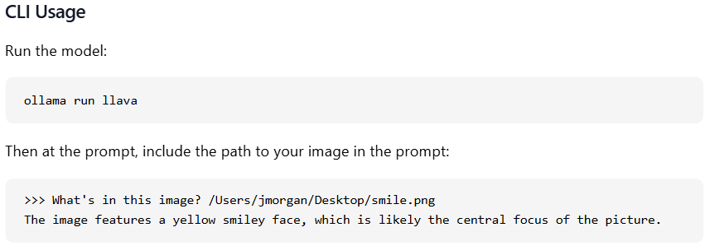
LLaVA: Large Language and Vision Assistant
Latest Features of LLaVA:

Slide 17
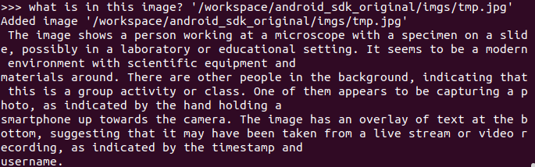
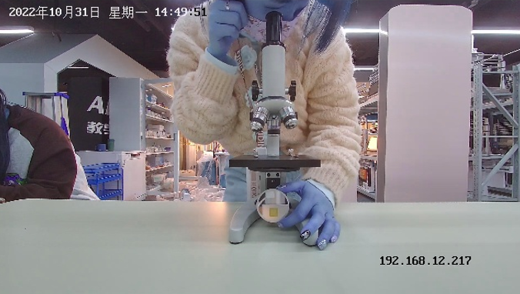
Demonstration: Chat with Ollama’s LLaVA Model
Chat with Images
Result
Input Images

Slide 18
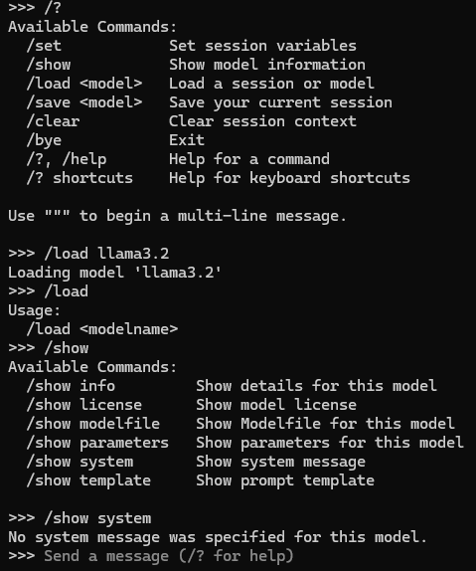
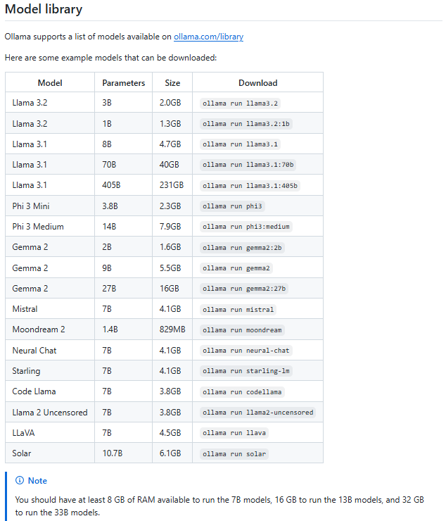


Extras:

